Slide 1
Productivity, a key to resilience and growth in uncertain times
March 25, 2025

Slide 2
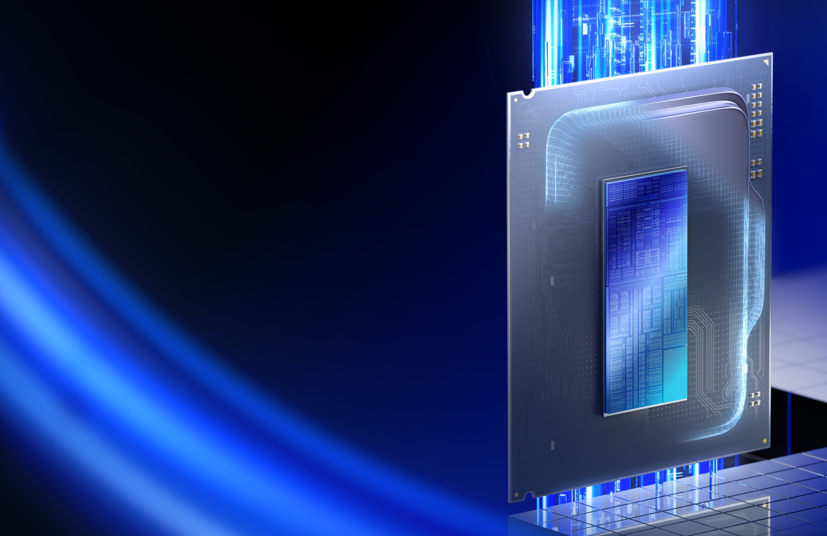
Introducing Arrow Lake
Powerful & Power Efficient
Highest multithread performance
Up to 24 cores for industry-leading compute throughput on desktop PCs¹
Power Efficient: half the power of 14th Gen Core
Skymont, Lion Cove, and Foveros team up for impressive perf/W gains
Feature-rich workstation experience
Xe-LPG for new codecs; ~36 TOPS for desktop AI PC; integrated Thunderbolt™ 4
Notes:
As we are now ready to launch, we’re very excited with the final family of products.
First, Arrow Lake picks up the mantle of Raptor Lake’s top end gaming performance and delivers parity performance at about half the power. It’s a huge leap in performance per watt, and Arrow is a perfect CPU for enthusiasts who want high performance in cooler and quieter systems.
And though we’ve reduced from 32 threads in Raptor to 24 threads in Arrow Lake, we still come out ahead in multithreaded performance both generationally and competitively. That’s great for creators, streamers, and power users, who rely on high core count CPUs like Arrow Lake, and it shows just how potent Skymont and Lion Cove cores can be in performance per thread.
And, finally, we also integrated new companion accelerators like Xe-LPG and NPU3 to round out a rich desktop experience. This includes top-tier AI support, support for cutting-edge codecs like 8K XAVC, integrated Thunderbolt 4, and more.

Slide 3
Arrow Lake Sets the Bar for CPU Compute
+18%
+19%
+11%
+14%
+4%
+7%
+5%
14900K
-7%
Geomean
15% faster nT performance
vs. prior gen
Geomean
13% faster nT performance
vs. competition
Relative performance (higher is better)
Intel® Core™ Ultra 9 285K (24 Threads)
AMD 9950X (32 Threads)
As of October 2024, among desktop processors targeting ~125W TDP; SPECrate®2017_int_base (n-copies) performance is estimated. See intel.com/performanceindex for details. Results may vary.
Notes:
Multithreaded performance is even more robust thanks to the new voltage and frequency characteristics inside Arrow Lake.
Where Raptor Lake occasionally encountered platform thermal or electrical thresholds that would clamp sustained compute, the superior power characteristics of Arrow allow the chip to keep pulling.
On a generational basis we’re nearly 20% ahead of Raptor Lake-R, and over 20% faster than the 9950X.
You really start to see how much performance our new microarchitectures can deliver on a per-thread basis when 24 threads in Arrow are outperforming 32 threads in both Raptor Refresh and Zen 5.

Slide 4
Arrow Lake Halves Productivity Power Consumption
14900K
Up to 58% lower package power in lightly-threaded work compared to Raptor Lake-R
-42%
-42%
-44%
-58%
Intel® Core™ Ultra 9 285K
Comparison of Intel Core Ultra 200S series processors against prior generation enthusiast desktop processors targeting ~125W TDP, based on average CPU package (SoC) power measured in watts across measured benchmarks and representative workloads. Results may vary based on use, configurations, and other factors. See intel.com/performanceindex for details.
Notes:
First, I think it’s fair to say that PC enthusiasts unfortunately cannot spend all their time gaming. Try as I might, they tell me I still need a “real life”.
That means you or I are probably on a web browser, some sort of word processor, on a conference call of some kind and so on.
We call these “everyday applications” or “day-in-the-life” apps, but whatever you call them: Arrow Lake basically chops the power consumption in half compared to Raptor.

Slide 5
Comprehensive Platform for IT Excellence
The Intel vPro® platform is a set of hardware, technologies, and
solutions that help organizations achieve better business outcomes.
AI performance
Productivity
XPU architecture for enhanced performance
NPU for efficient local AI inferencing
Premium connectivity solutions
Security
Secure by design for modern computing
Reduced attack surface
A more secure foundation for AI apps and data
Multi-layer hardware-based security strategy
Versatile Valuable Verified
Greater endpoint visibility and control for AIOps
Manageability
Minimize costly downtime
NEW Now supporting all types of IT deployments – cloud, on-premises, service provider, or direct
Stability
Enhanced validation and assurance
Application compatibility
Comprehensive platform validation
No hardware changes and flexible software updates²
213% ROI¹
Built-in features to support sustainability throughout the device lifecycle
Click here for further details on all numbered footnotes. Additional information available in appendix and at intel.com/performanceindex. Results may vary.

Slide 6
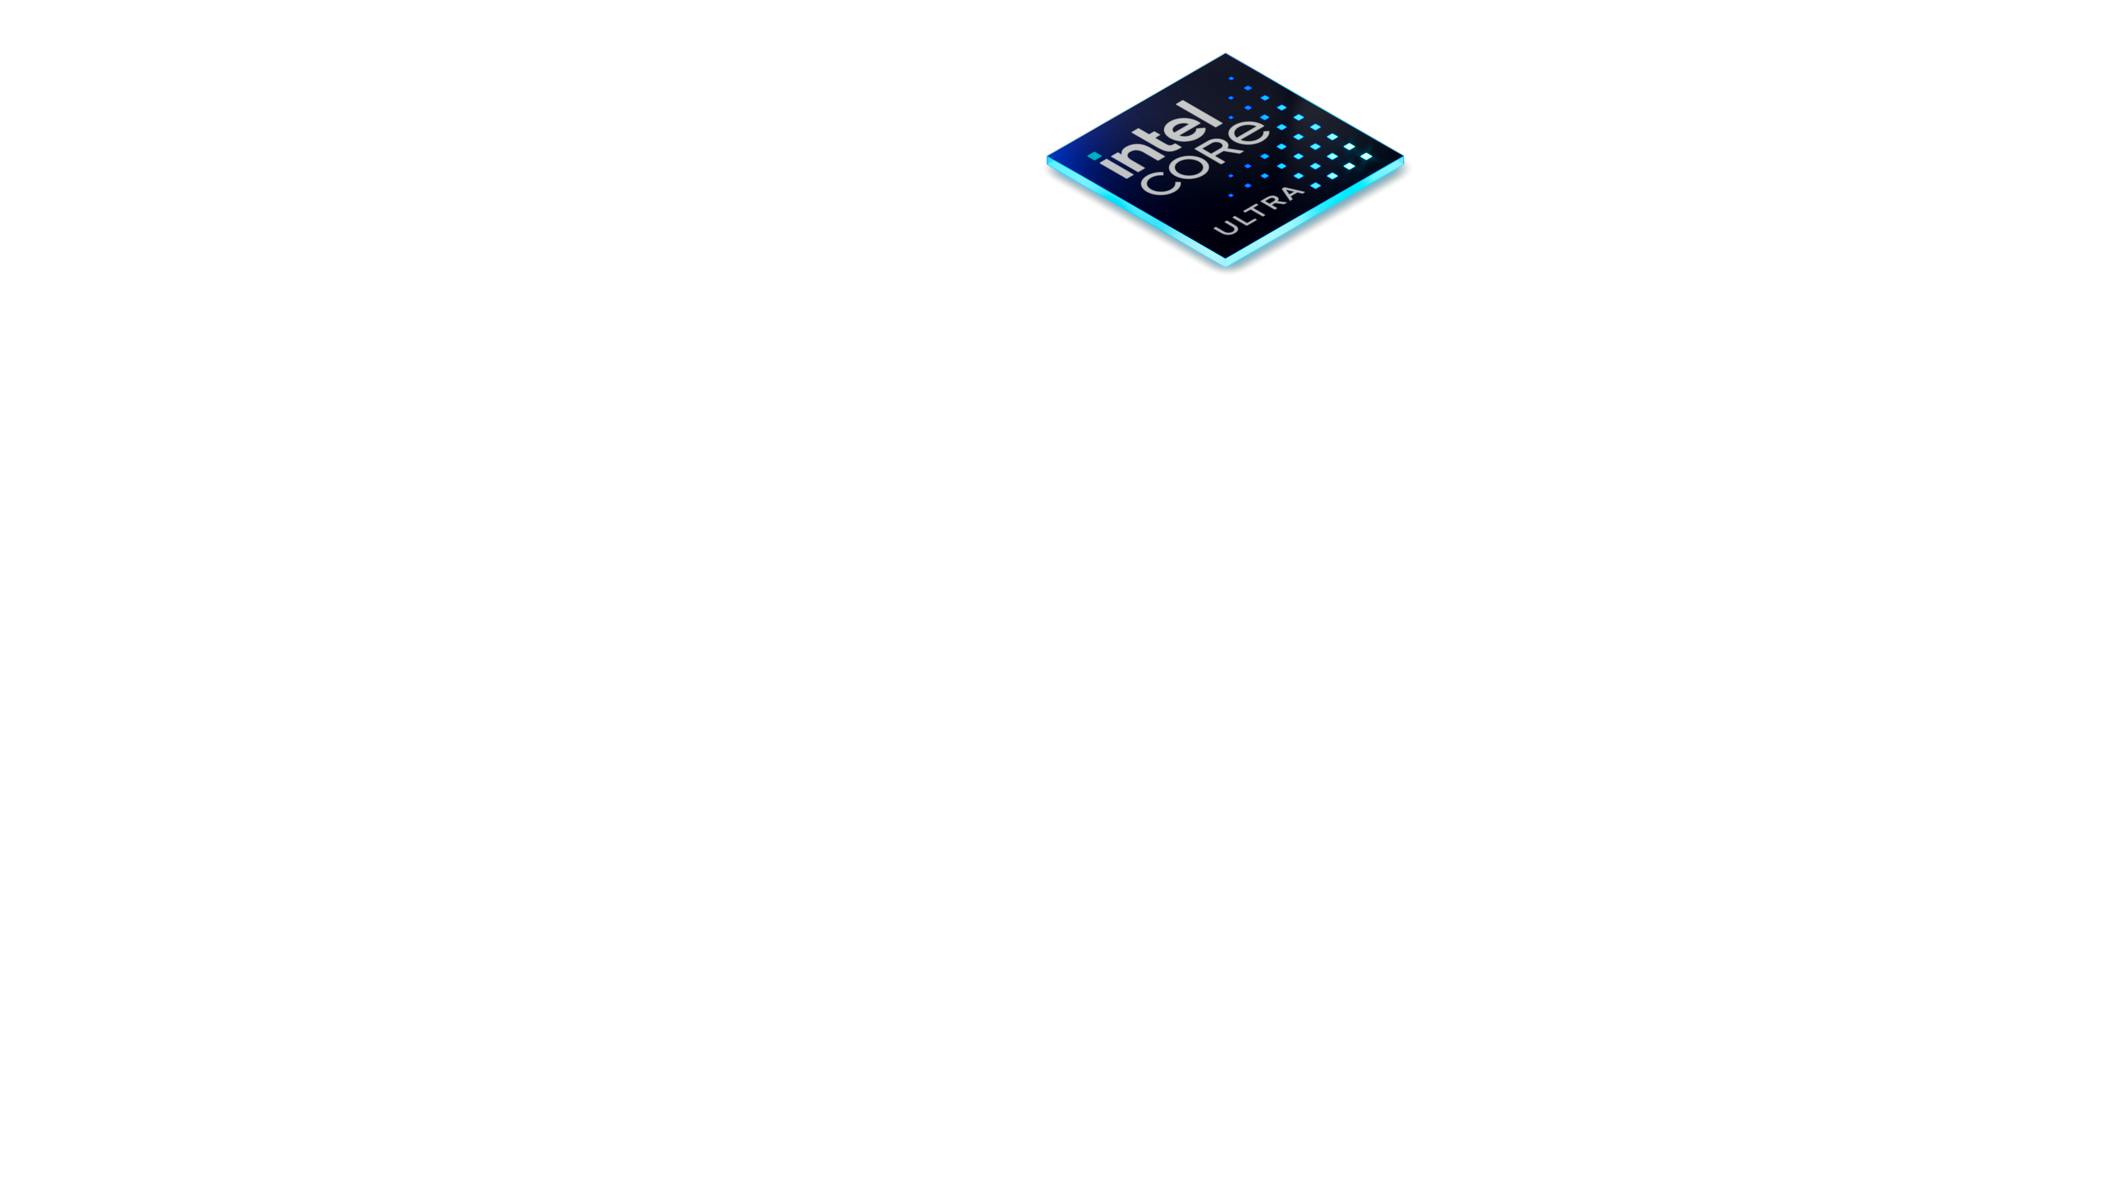
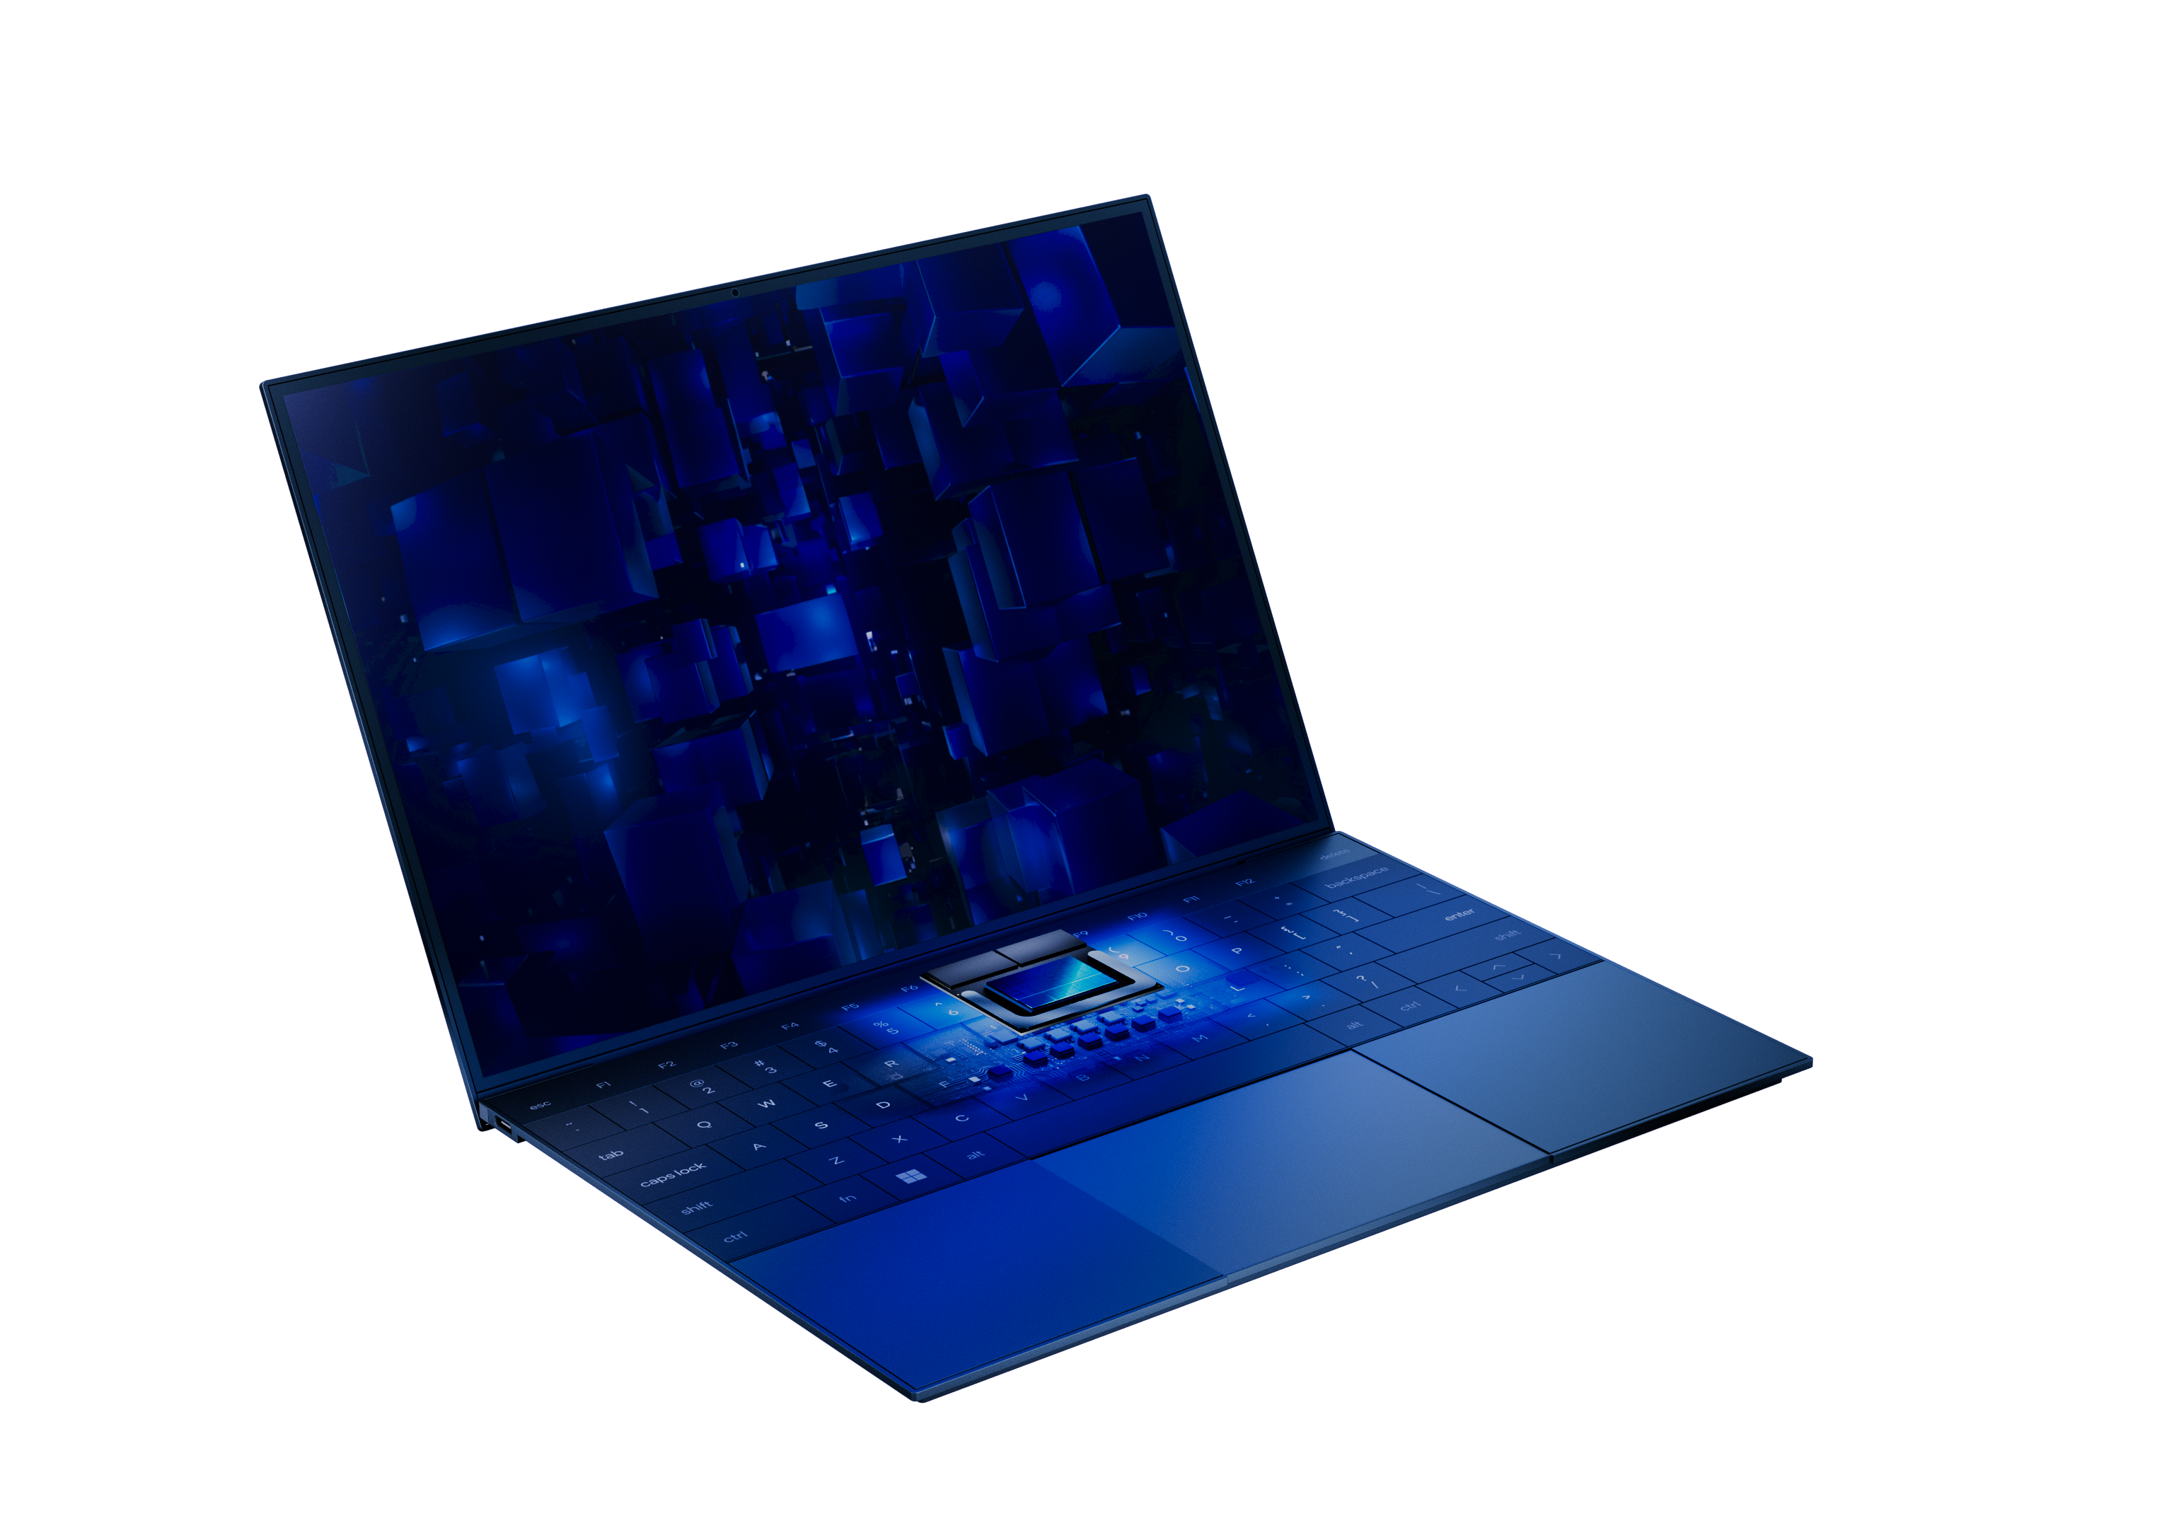
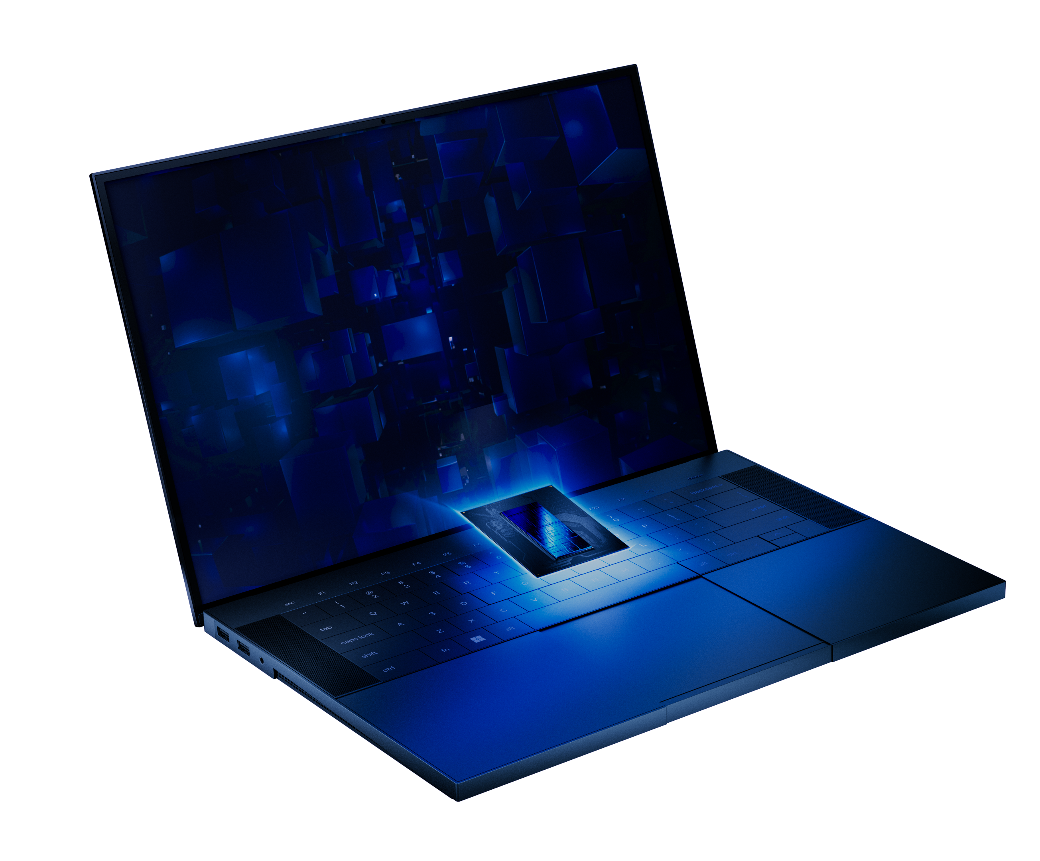
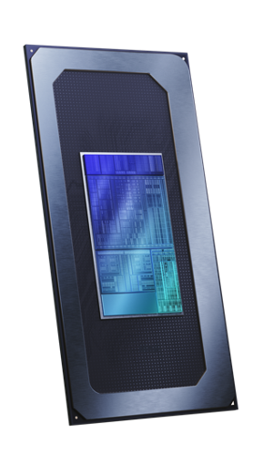
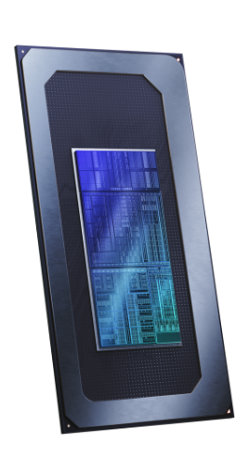
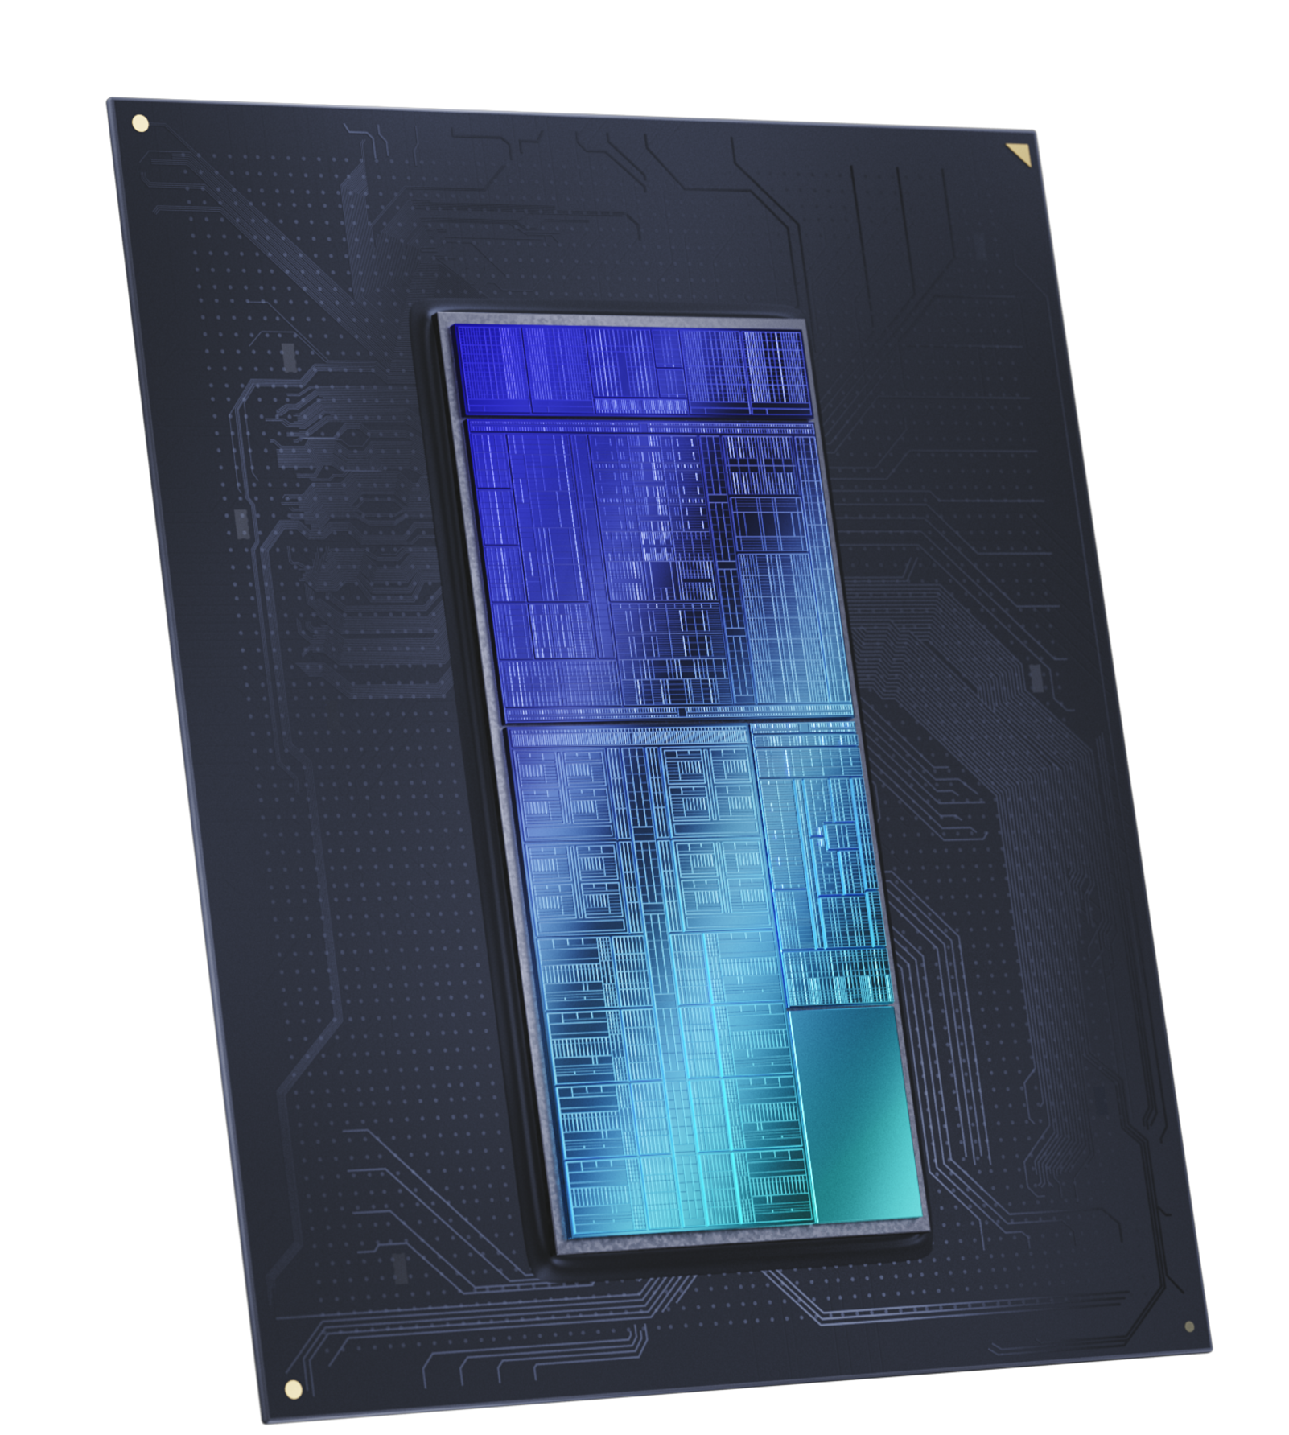
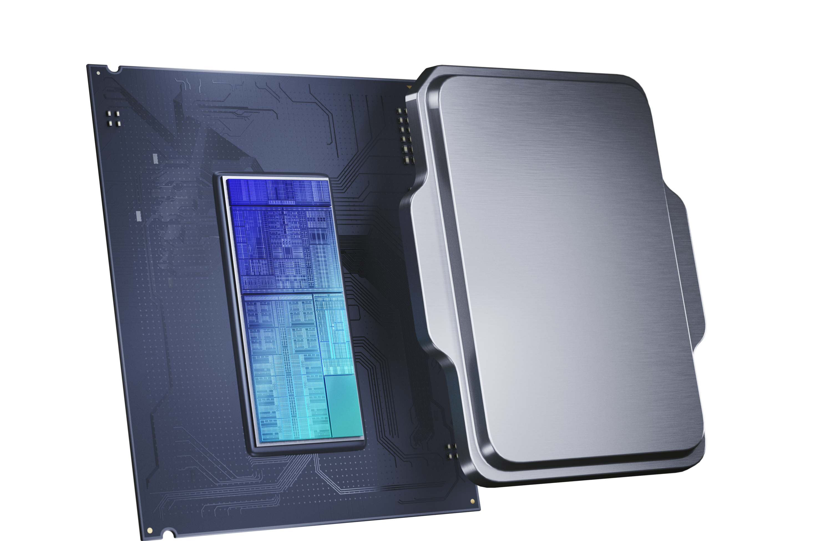
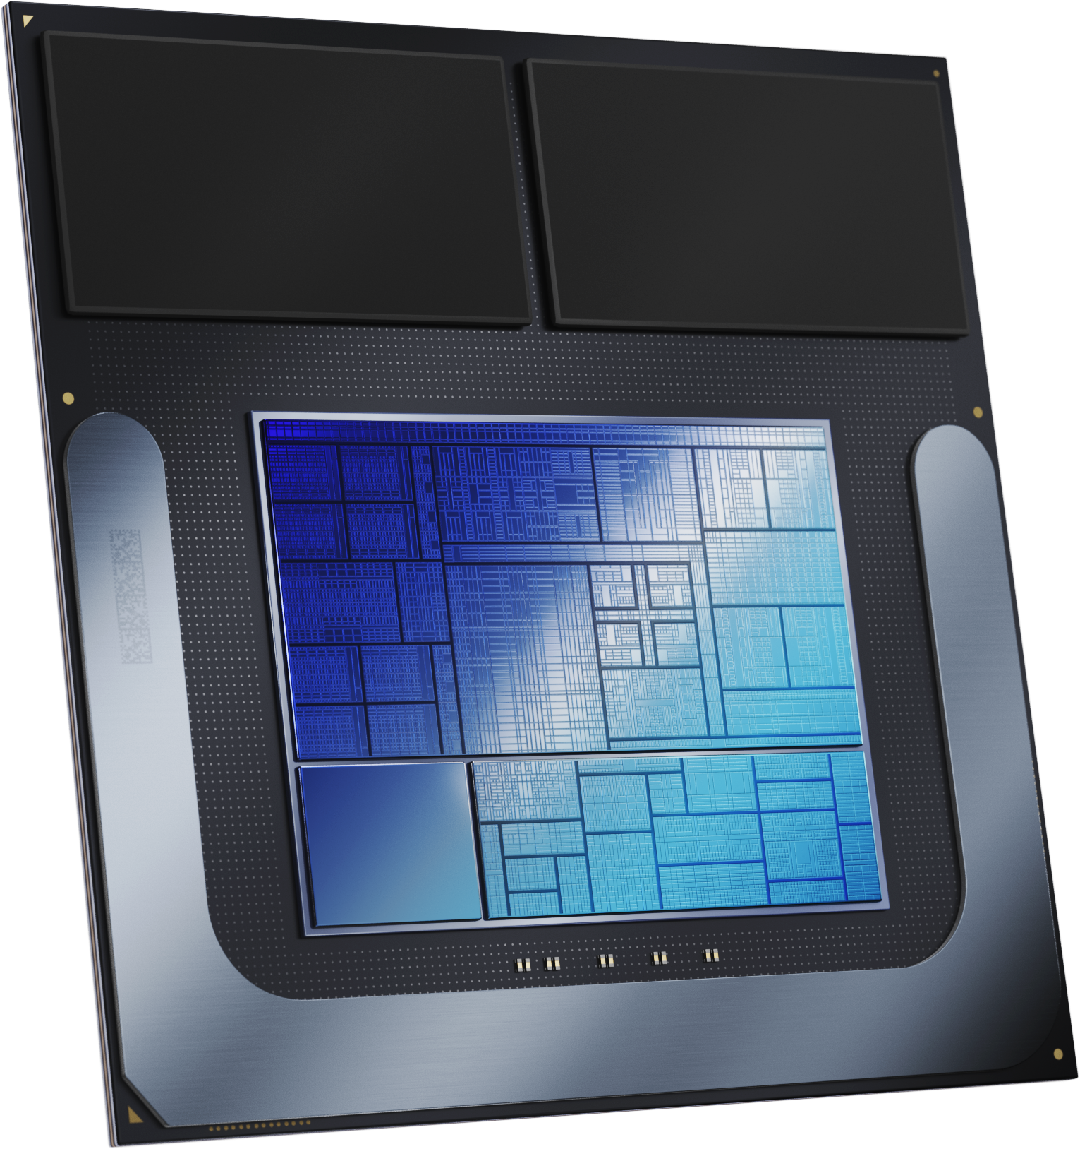
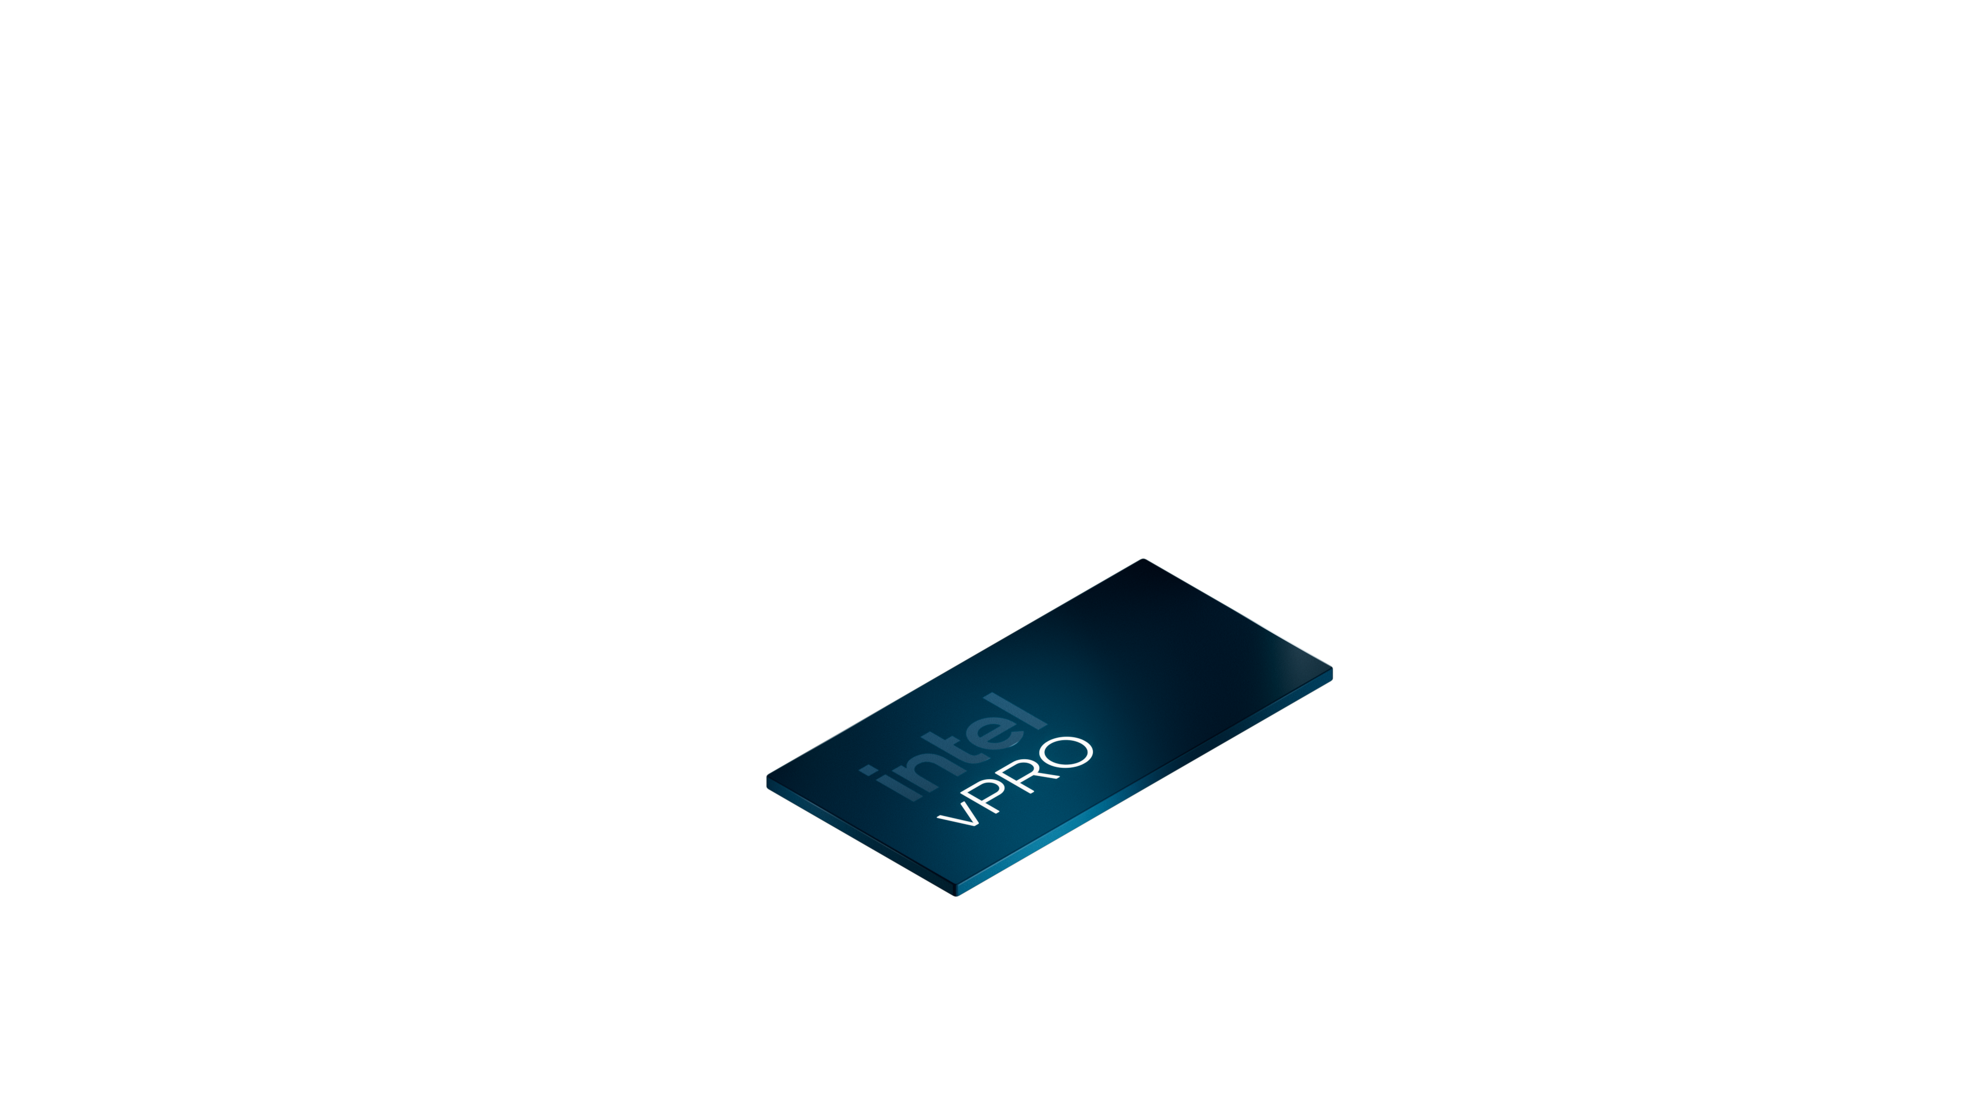
Intel, Designed for Businesses of All Sizes
Thin & Light Laptop
Mobile Workstation
Desktop & Workstation
Intel® Core™
Ultra 200V
Lunar Lake
Intel® Core™
Ultra 200U
Arrow Lake
Intel® Core™
Ultra 200H
Arrow Lake
Intel® Core™
Ultra 200H/HX
Arrow Lake
Intel® Core™
Ultra 200S
Arrow Lake
Reach out to your HP and Intel Sales Rep to learn more about how
HP with Intel Inside can you help unlock productivity across your enterprise!
Notes:
Rest assured as we move forward into 2025 Intel will have a full portfolio of processors, for all form factors – commercial NBs, Desktops and Workstations. But, for today, let’s look under the hood of Core Ultra Series 2.
And, with that, please let me turn it over to my colleague, Afshin Abadi.

