Slide 1

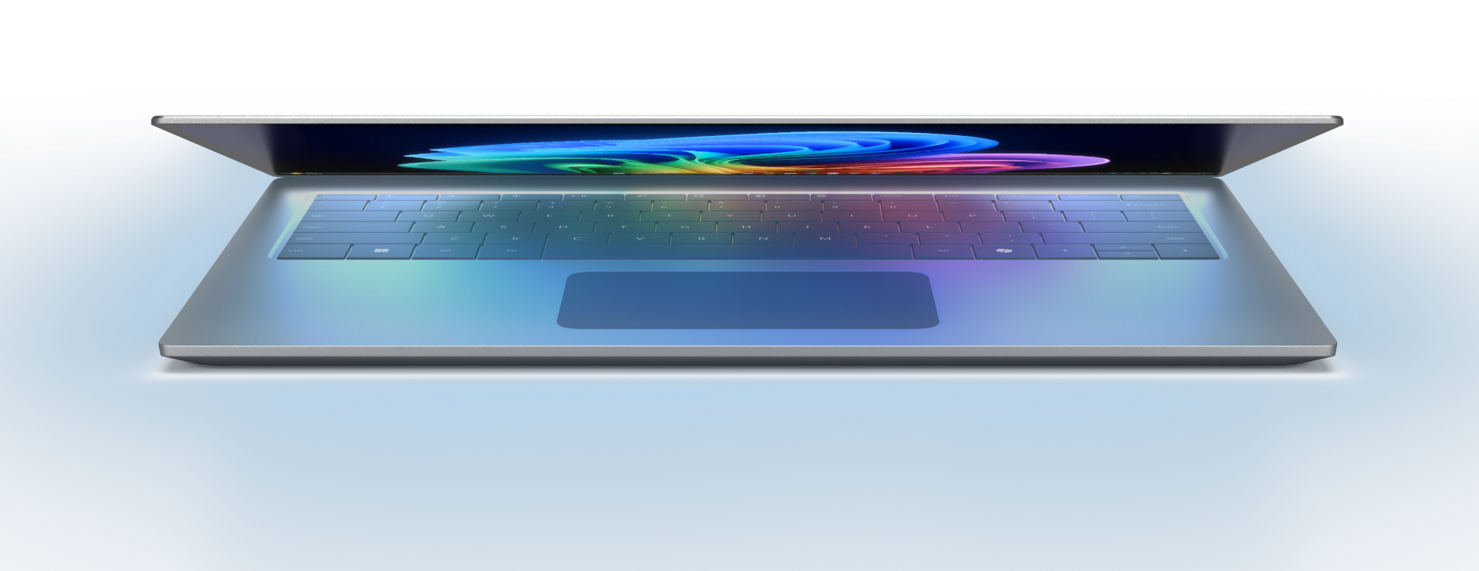
The platform for work
Notes:
Today I want to show you how Windows is going to continue to remain the platform for work. This deck can be downloaded and used for customer meetings. It is designed to be about 5-10 min long and includes the most up to date messaging. I will go through the pitch for you today but let me know if you have any questions or need any assistance when delivering to your customers.

Slide 2

Windows as the platform for work
Thriving businesses are balancing security with AI innovation to drive operational efficiency
40% of data security professionals are reporting an increase in data security incidents from the use of AI.¹
40%
82% of business leaders say this is a pivotal time to rethink core aspects of strategy and operations.²
We’re on a mission to bring secure, business‑ready AI to every organization on the planet, so people work smarter and IT stays in control.
82%
Data Security Index 2024, Microsoft
Work Trend Index Annual Report: 2025: The year the Frontier Firm Is Born, Microsoft
Notes:
It’s no surprise that operational efficiency is becoming a top priority for today’s businesses.
We’re all feeling the pressure, industries are being reshaped by AI, and the pace of business is faster than ever. Commercial customers are feeling the tension between introducing new innovation while balancing this with security risks.
40% of data security professionals are reporting an increase in data security incidents from the use of AI, while 80% of employees and leaders say they simply don’t have enough time or energy to get through their work. A capacity gap that they are planning to fill with AI.
And it’s not just about keeping up. According to Microsoft’s 2025 Work Trend Index, 82% of business leaders believe this is a pivotal moment to rethink core strategies and operations. That’s huge.
That’s where we can solve for this gap. Windows is the platform for work, and we’re on a mission to bring secure, business‑ready AI to every organization on the planet, so people work smarter and IT stays in control.

Slide 3



Evolution of AI
Phase 1
Phase 2
Phase 3
Human with assistant
Human-led agents
Human-led, agent-operated
Every employee has an AI assistant that helps them
work better and faster
Agents join teams as “digital colleagues,” taking on specific tasks at human direction
Humans set direction and agents run entire business processes and workflows, checking in as needed
Notes:
I want to set some context on our journey with AI and where we see it going, especially with the explosion of agentic capabilities:
Phase one, is a human with an assistant
In Phase 2 agents become part of teams working side-by-side along humans.
In Phase 3, we begin seeing teams comprised of agents – humans provide direction and agents can run entire teams or departments.
This won’t be a linear journey - Organizations will have teams and functions operating at all levels and no matter where you are, you can build the base for AI innovation in the future

Slide 4
Your canvas for AI
Windows powers your business with smart tools that work, security by default, and performance you can count on.
Windows as Agentic OS
Empower next-level AI productivity with Windows as the agentic operating system integrating Microsoft 365, Copilot, and agents deeply into the shell for seamless workflows and intelligent automation.
Security &
Management
Deliver advanced security and streamlined management in Windows and Intune simplifying IT and reducing total cost of ownership.
Fundamentals
& Resiliency
Highest performing devices built on strong and consistent fundamentals with planet-scale resiliency providing reliability and confidence for mission-critical operations.
Windows
Cloud
Extend Windows agentic capabilities beyond the device with Windows Cloud unlocking business-ready AI and agent capabilities anywhere, on any Windows endpoint.
Notes:
Windows is your canvas for AI. We are investing in four areas to help every organization get business‑ready AI that is secure by default, resilient in practice, and available on any Windows endpoint.
1) Windows as an agentic OS We are reinventing Windows for people and agents. Microsoft 365 Copilot will be integrated across workflows AND is the common interface and control layer for agents, making intelligent help feel native and consistent across the experience. Agents are coming into Windows and integrating deeper into the shell so employees can become managers of many agents.
2) Security and management Security and management remain our differentiation. Every agent capability is governed, auditable, and policy‑driven in the tools IT already uses, like Intune and Microsoft Admin Center, so you can see actions taken, set guardrails, and keep data protected while people stay productive.
3) Fundamentals and resiliency We continue to raise the bar on performance, reliability, and fit‑and‑finish. We are completing UX polish like consistent dark mode and clearer Settings, while delivering resiliency features that help you diagnose, roll back, and recover quickly when the unexpected happens.
4) Windows Cloud Only Windows pairs the PC with the power of Azure. With Windows 365 for Agents we extend the Windows platform into the cloud so that we can provide agentic capabilities and experiences to any device.
Together, these investments make Windows the place where people and agents work as one, with security you can trust, performance you can count on, and the reach of the cloud to run anywhere.
Let’s take a look at how we are bringing this to life in Windows.

Slide 5


Slide 6

Business-ready AI built into Windows
Microsoft 365 Copilot
Agents
Security & management
Microsoft 365 Copilot in the flow on Windows
Ask Copilot
Voice
Windows Agentic Workspace with Agents on the taskbar
MCP enablement
Isolated & Auditable
Hardware-backed security
Fleet insights & automation
Built-in resiliency
Microsoft 365 Copilot offline
More features
Instant results
Local Agentic Workspace
On-device agents
Secure processing
Secured-core + Pluton
AI feature management
Enterprise ISV apps
5 hours saved
Expected time-savings per employee each week through speedier workflows, freeing time for other valuable work.¹
50% reduction
Up to 50% expected reduction in help-desk efforts due to faster provisioning, remote setup, & content discovery. ¹
70% blocked
Copilot+ PCs estimated to block 70% of typical breach vectors for up to 15% reduction in threat exposure. ¹
New Tech: The Projected Total Economic Impact™ of Microsoft Copilot+ PCs. Microsoft-commissioned study by Forrester Consulting, July 2025. Projected benefits for a single composite organization that has US$1 billion annual revenue and 2,000 employees with 80% using Copilot+ PCs. In comparison to a mixed environment of conventional Windows 11 and Windows 10 PCs.
Notes:
We are creating business-ready AI value in Windows across three core areas; Microsoft 365 Copilot on Windows, agents, and security & management.
Microsoft 365 Copilot
On Windows M365 Copilot, we bring AI into the OS to accelerate work. With voice, and Ask Copilot, employees can research, draft, and act faster right from the task bar, hands‑free, while Copilot understands on‑screen context and keeps workflows secure and under control.
On a Copilot+ PC, M365 Copilot connects deeply with Windows for faster, more fluid productivity. Voice respond with lower latency, and select features work offline. With Copilot+ PC features like Click-to-do you can supercharge Copilot by connecting directly to your workflows.
Agents
Windows agentic workspace provides a secure execution environment where agents run with system context, MCP enablement, and governed access. The Agent Workspace isolates activity, connects to enterprise systems, and hands back results for review and audit. Any agent that runs in the agent workspace can show up on the taskbar to provide status and ask for help using Windows notifications.
On Copilot+ PCs, advanced agent workloads can run locally in the Agentic Workspace for speed, privacy, and resilience. This local execution leverages on-device NPUs for low-latency performance, enabling agents to process sensitive tasks without sending data to the cloud.
Security & management
Windows 11 delivers hardware‑backed protection, identity safeguards, and advanced app control by default. With fleet insights, automated remediation, and Intune‑orchestrated rollback and recovery, you keep people productive even when issues arise.
Copilot+ PCs raise the bar with Secured-core and Microsoft Pluton built in, adding chip-to-cloud protection against attacks. Take advantage of every Windows security feature offering the strongest foundation for resilience and simplified management at scale.
These Copilot+ PC enhancements deliver real results. Forrester found employees using Copilot+ PCs saving up to five hours each week on faster workflows and AI powered features. IT sees up to 50% percent fewer helpdesk tickets due to faster provisioning and support, and security improves with Secured‑core and Microsoft Pluton helping block about 70 percent of common breach vectors.
We also have 100’s of ISVs building on the platform. A couple of notable examples include:
Adobe Creative Cloud is now Arm‑native on Copilot+ PCs for core apps like Photoshop and Lightroom, with Premiere Pro and After Effects in public beta. Adobe is also bringing NPU‑accelerated workflows to Windows via DirectML, starting with capabilities like Audio Category Tagger in Premiere Pro.
Roboflow Roboflow Inference runs locally on Windows, enabling on‑device computer vision for edge scenarios and private data – they are producing an app where instead of talking down a container line in a shipping yard with a clipboard noting container details, a car with cameras hooked into a CP+ PC can just drive down the line and the container information will be automatically pulled and catalogued. It can route models through Windows ML and DirectML to tap the NPU on Copilot+ PCs. Computacenter Computacenter has created an application for their warehouse workers which uses multiple models to pull device ID information off boxes and one-click upload into Intune and Autopilot incl. esim for phones etc. This is saving their staff up to 10 minutes per device. The data is pulled dynamically so no extra steps needed.

Slide 7



Frontier Firms run on Windows
Levi’s Windows 11 & Copilot+ PC Transformation: Modern, Secure, and AI-Powered for Retail Innovation.
Levi’s is modernizing operations with Windows 11 and Copilot+ PCs, driving secure endpoint management and productivity across retail and corporate environments. Anchored on Windows 11, Levi’s combines enterprise-grade security with intuitive AI experiences, empowering employees to innovate faster and deliver measurable business outcomes.
Suncorp’s Windows 11 & Copilot+ PC Transformation: Secure, Productive, and Scalable AI for Financial Services
Suncorp moved from AI experimentation to enterprise-scale GenAI, anchored on Copilot+ PCs and Windows 11, boosting security and productivity for every employee. Windows 11 provides a trusted foundation for AI-driven workflows, enabling Suncorp to innovate responsibly and improve collaboration across its financial ecosystem.
Banco do Brasil’s Windows 11 Workspace: Unified, Secure, and Built for Collaboration.
Banco do Brasil is standardizing on Windows 11 to strengthen security and streamline operations across thousands of branches, improving employee experience and compliance. With Windows 11 Banco is accelerating digital transformation, enabling AI-powered insights and collaboration that drive efficiency and customer trust.
Notes:
I wanted to give you some examples of Frontier firms are choosing Windows to lead their transformation, with Levi’s and Suncorp both choosing to standardize on Copilot+ PCs because of the many benefits we just talked about.
Levi’s is reinventing retail with secure, AI-powered experiences that drive measurable business outcomes.
Suncorp is scaling AI responsibly across its financial ecosystem, boosting productivity and security for every employee.
Banco do Brasil is unifying operations on Windows to strengthen security and accelerate collaboration across branches.
These leaders show how Windows enables innovation, resilience, and growth at global scale.

Slide 8
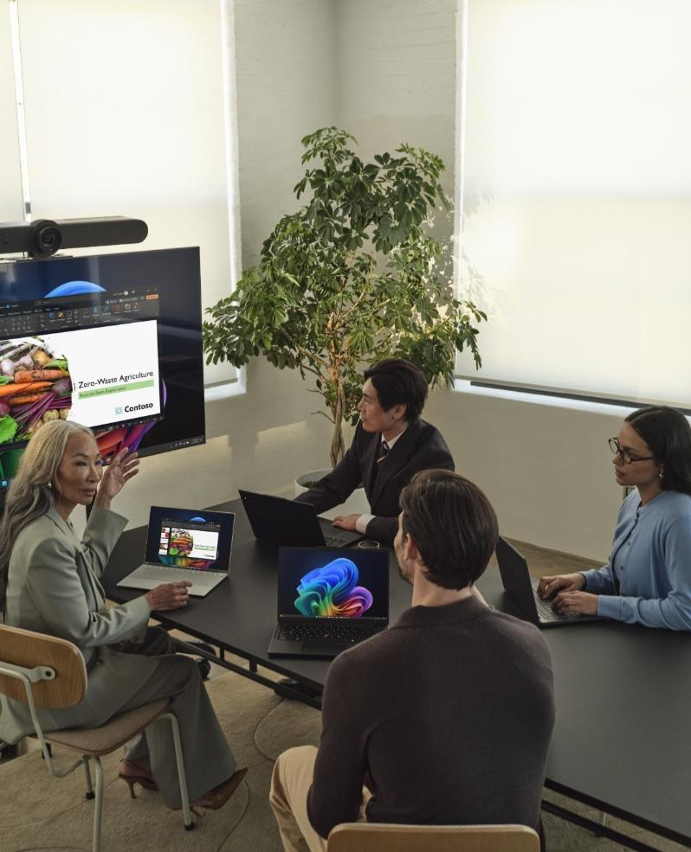
Key takeaways
Your journey starts now
01
Modernize your estate with Windows 11 for a secure, manageable foundation for AI and future work.
02
Refresh aging hardware with secure, high-performance devices, standardize on Copilot+ PCs to get the best of Windows 11.
03
Deploy Microsoft 365 Copilot¹ to make AI the front door to work.
04
Become a frontier firm, explore Microsoft Foundry on Windows to create custom agents and workflows.
1 Per user license sold separately; also requires eligible Microsoft 365 plan.
Notes:
Your journey starts now. Here is the plan in four moves.
Modernize the estate with Windows 11. First, get on a secure, manageable foundation. Windows 11 gives you the controls, updates, and baseline security you need so AI can be deployed with confidence.
Refresh hardware and standardize on Copilot+ PCs. Next, retire aging devices and move to high‑performance Copilot+ PCs. You unlock on‑device AI speed, better battery life, and the best Windows 11 experience at scale.
Make Microsoft 365 Copilot the front door to work. Then, put Copilot where people start their day. Target the top workflows in Office and Teams, apply data governance, and measure time saved and outcome quality.
Build your own agents with Microsoft Foundry on Windows. Finally, go from using AI to shaping it. Use Foundry to create custom agents and workflows for your highest‑value scenarios, with security and control baked in.
Close: Execute these four steps and you get a secure, governed platform, faster employees, and a clear path to differentiated agents. We can help you sequence this by quarter and track impact from day one.
Team, thank you for your time today. Remember, you are welcome to download this deck and use it to deliver the brand new CP+ PC messaging and don’t hesitate to reach out to me with questions.

